Slide 1
An overview of management algorithm of type 2 DIABETES
Dr. Mathew job vachaparampil

Slide 3
Legacy effect

Slide 4
Normal / IFG/IGT/OVERT T2 DIABETES
NORMAL
FPG < 100MG/DL
2hr PG <140
prediabetes
IFG – FPG>100- 125
IGT→2hr PG >140-199
Overt DM
FPG >=126
2hr PG >= 200 or random PG >200 plus symptoms of hypergycemia
A1C< 5.5%
A1C 5.5 -6.6%
A1C >=6.5%

Slide 5
Priniciples to be followed
Lifestyle optimisation
Minimising the risk of both severe and non severe hypoglycemia
Minimising the risk of weight gain and promoting weight loss
HbA1C targets should be individualised.
Choice of anti diabetic therapy should be individualised based on cardiac,cerebrovascular and renal status
Management of lipid and bp abnormalities

Slide 6
Lifestyle therapy
Key components include
medical nutrition therapy and healthy eating patterns
regular and adequate physical activity, sufficient amounts of sleep,
behavioral support,
and smoking cessation with avoidance of all tobacco products

Slide 7
Medical nutrition therapy
Maintain optimal weight
Primarly plant based diet
High in PUFA and monounsaturated FA
Overweight and obese patients
Restrict their calories intake
Initial goal is to reduce 5-10% weight to reduce obesity related complications
education
Educate the patients about the need for consistency in day to day carbohydrate intake
High glycemic index foods
Avoid saturated FA and trans fats
Then target appropriate long term goals for optimal anthropometrics
Limit high sucrose and fructose diets
Healthy high fibre breakfast,not skipping meals
Avoid unhealthy eating late at night

Slide 8
Doctor, what change
Should I make in my diet?

Slide 9
We must help patients to understand
What to eat
How to eat
How much to eat

Slide 10
Dietary pattern
Dietary pattern of the diabetic should be same as that of other members of the family
There is no need to separately cook their food
But it should be healthy and well balanced that is suitable for other members also
Drink 8 to 12 glasses of water

Slide 11
For an average person
Daily calorie intake should be restricted to 1500kcal /day
50-60% ie,about 800kcal should be carbohydrates
20 to 30 g of fibre per day
About 20% of calorie should be from proteins
And fats should be about 10%
Knowing the calorie content of the commonly used foods will help patient to calculate the total calories.
A balanced diet is a diet where there is proper balance in the choice of food grains ,meat,fat,vegetables ,fibre and water

Slide 12
1gm carbohydrate = 4kcal
1gm fats = 9 kcal
1 gm protein = 4kcal

Slide 13
Food pyramid
Rice, wheat,grains –eat more of these
Fish,meat eggs and milk –eat a little
Oil,fat,sugar salt
Vegetables and fruits

Slide 14
Beans and legumes
All the different type of beans are good
Sprouted beans enhance the protein content
Try to include a bean food atleast in one of your meals daily.

Slide 15
Fish, meat, eggs
Do include fish in your daily diet
Fish contains omega fatty acids which help to protect heart
Avoid fry
Prefer fish curries
Mathy , ayala and choora are rich in omega FA
Meat can be had twice a week
Limit mutton(high saturated fat content)
Limit consumption of eggs to once or twice a week

Slide 16
Vegetable, greens ,fruits
Try to include green leafy vegetable in every meal
One quarter of the plate should be vegetables and salads
Fruits should be included in daily diet

Slide 17
Food with high fibre
Grains with bran
Beans and other bean varieties with their skin
Vegetables
Green leafy vegetables
fruits

Slide 18
PUFA AND MUFA
Mufa is found in vegetable oils such as olive,peanut and canola oil and remain liquid at low temp
Pufa are found in vegetable oils such as corn oil,safflower oil and soyabean oil

Slide 19
Saturated fats
Usually solid at room temp
All animal fats such as those in meat, poultry,and dairy products
Processed foods and fast foods
Some vegetable oils like palm oils, coconut oil
Saturated oils increase LDL and total cholesterol

Slide 20
Avoid as far as possible
Bakery products
Porotta
Soft drinls ,fresh juice snacks
Limit intake of salt
Do not take take too many cupsw of coffee or tea
Mangoes , jackfruit , and dried fruits.

Slide 21
Calorie contents of some foods
 | quantity | calorie
chappathi | 25gm wheat , 1no | 80
idli | 1 no | 80
rice | 25gm ½ cup | 86
Brown bread | 1 slice | 60
noodles | Ipack 100gm | 435
samosa | 1 | 260
Potato nchips | 100gm | 570
Jilebi |  | 200
Coffee with no sugar |  | 25

Slide 22
Fruits safe in DM
Berry
Kiwi
apricot
Apple
Citrus fruits
Orange
guava

Slide 23
ABCD(adipose tissue based chronic disease)
AACE has advoated ABCD as a better diagnostic term to define obesity as a disease.
Weight loss must be considered in all patients with ABCD, since it improves insulin sensitivity, lowers glycemia, improves lipd profile and BP
Prevents progression of prediabetes to overt DM
Wt loss also prevents NAFLD, OSA and mechanical complications in patients with ABCD
There has been a shift from BMI centric approach to complications centric model in the management of obesity

Slide 24
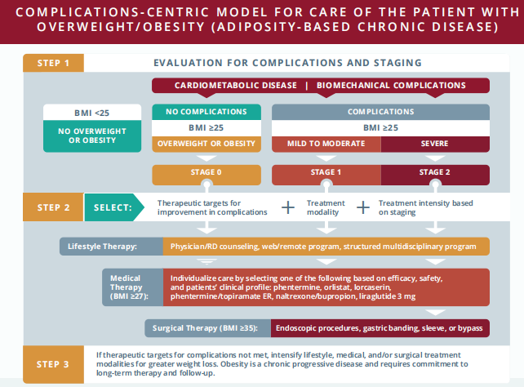

Slide 25
Prediabetes
IFG
IGT
Insulin resistance (metabolic syndrome)
Primary goal of management is weight reduction in overweight or obese pts
Through Lifestyle therapy ± pharmacotherapy and / surgery
For pts with IGT that persists despite lifestyle changes and weight loss, anti hyperglycemic drugs such as metformin and acarbose reduce the risk of future diabetes.
No medications (either wt loss drugs or antihyperglycemic agents) are approved by FDA solely for the Mx of prediabetes

Slide 26
Blood pressure
AACE recommends a target of <130/90, but can be individualised.
In ACCORD-BP trial,no difference in CV outcomes or all cause mortality between standard therapy and intensive therapy(mean bp -119/64)
A metaanalysis of antihypertensive therapy in patients with type2 DM, showed that below 130mmHg, stroke and nephropathy decreased but not cardiac events
Choice of drugs- ace/arb/beta blockers/diu
DASH diet (low in Na and high in K) can be used in all Hypertensives with T2DM and without renal insufficiency.

Slide 28
Individualisation of HbA1C
In adults with recent T2D onset and no clinically significant ASCVD, an A1C ≤6.5% if achieved without substantial hypoglycemia or other unacceptable consequences, may reduce the lifetime risk of micro- and macrovascular complications.
A broader A1C range is suitable for older patients and those at risk for hypoglycemia.

Slide 29
A less stringent A1C >6.5% is appropriate for patients with a history of severe hypoglycemia, limited life expectancy, advanced renal disease or macrovascular complications, extensive comorbid conditions, or long-standing T2D in which the A1C goal has been difficult to attain despite intensive efforts
Aim to make the patient remain free of polydipsia, polyuria, polyphagia, or other hyperglycemia-associated
symptoms.

Slide 30
Metformin
Low risk of hypoglycemia
Has robust CV safety relative to SU
Safe in ckd with eGFR>30
Reduction in total daily dose is prudent in pts with eGFR between 3o and 45ml/min/1.73m
Responsible for vit B12 malabsorption/deficiency in upto 16% of users
Hence in pts taking metformin, who develop neuropathy, B12 should be monitored and corrected if needed.

Slide 31
Rare adverse effects include pancreatitis, hepatotoxicity
Maxiumum dose 2 to 2.5 g/day

Slide 32
sulphonylureas
Chlorpropamide,
Glyclamide
tolazamide
Glibenclamide
Glipizide
gliclazide
glimepiride

Slide 33
Important points….
Secretagogues- acts on the beta cells and stimulates them
Actions decreases with duration of illness.
Max glucose lowering action of SU is usually attained at appreciably lower doses (apprx 50%)
Rather than uptitrating metformin to more than half max dose, addition of SU to metfomin demonstrates better glucose lowering efficacy and safety.
Compared to DPP4 →more glucose lowering efficacy, but causes wt gain and chance of hypoglycemia

Slide 34
Compared to GLP1 agonist, they show similar glycemic efficacy with acceptable safety and at lower cost
UKPDS trial reported that each 1% reduction in A1C decreases apprx 12-43% of diabetes related mortality and morbidity.

Slide 35
Ischemic preconditioning
Binds to SUR on beta cells –blocks ATP dependent K channels
Affinity of Sus varies with different SUR subunits present in K ATP channels
GLIB blocks both SUR1(pancreatic cells) and SUR2 (cardiac and skeletal muscles) subunits with similar affinity.
This produces a theoritical disadvantage of affecting ischemic preconditioning.
GLIMI blocks SUR1 and preferentially the sarcolemmal SUR2 while sparing the mitichondrial SUR2
GLIC selectively blocks SUR1 compared to SUR2.

Slide 36
Pharmacokinetics of SU
SU
Glimepiride
DOA- 24hrs
Once daily dose
Gliclazide
DOA- 12hrs
Twice daily dose
Glipizide
DOA 12 hrs
Twice daily dose
Glibenclamide
DOA -16 to 24

Slide 37
SU and CKD
Glibenclamide is metabolised in liver and has active metabolites, excreted through kidney and intestine
Glimepiride is metabolised by the liver to major metabolites are excreted through kidney
Safe in GFR>60
Long acting – glimepiride
glibenclamide
Short acting – glipizide
gliclazide

Slide 38
Gliclazide is metabolised by liver to inactive metabolites that are eliminated in urine,hence causes less hypoglycemia than other SU
Safe in eGFR >30
No data in patients with stage 4/5 CKD, but according to metabolism, it can be used in reduced dose.
Glipizide also does not need dose adjustment in severe and moderate renal ds.

Slide 39
PRICE !!!!!!
40p/tab
2.5/5/10 mg
Use me !!
glipizide
glimepiride
5rs /tab
1-8mg
1.5rs/tab
40/80mg
gliclazide

Slide 40
SU s and RAMDAN
Modern SU may be used in combination with other drugs during Ramdan, with appropriate counselling and dose modification
Individuals woth once daily SU should take their drugs at iftar
Those on twice daily dose, may shift their morning dose to iftar and half of evening dose dose to suhur(morning meal)
Those on SU and premixed insulin should reduce the dose of either drug or shift from premix to low peak basal insulin
Dose titration during Ramdan should be based on twice wkly or weekly monitoring.

Slide 41
GLP1 agonists
Glucose dependent insulin release from beta cells
Inhibits glucagon release
Delays gastric emptying
Enhances satiety
Improves insulin sensitivity
Weight loss, bp and lipid reductions.
LEADER trial(liraglutide effect and action in diabetes,evaluation of CV outcome Results)- significant reduction in nephropathy and death from CV outocmes.

Slide 42
Liraglutide has received FDA approval to reduce the risk of CV death, non fatal Miand non fatal stroke in adults with type2 DM and established CV disese.
SUSTAIN 6 trial – semaglutide(ORAL)
REWIND trial –dulaglutide
HARMONY trial- albiglutide
these trials suggests these GLP1agoists also have CV benefits.

Slide 43
Should not be used in patients with a personal or family history of medullary thyroid cancer or MEN type2
Exenatide is CI below eGFR of 30
No dose adjustments liraglutide,semaglutide and dulaglutide in ckd
Needs caution in patients with gastroparesis.

Slide 44
SGLT2 inhibitors
EMPA-REG outcome trial- empagliflozin lowered the rates of all cause mortality ,CV death and hospitalisation for heart failure.
CANVAS trial – canagliflozin (increased the risk of amputation)
DECLARE TIMI trial- dapagliflozin
Most of the benefits in the trials are from heart failure related end points.
In adults with T2D and established ASCVD, empagliflozin has an FDA-approved indication to reduce cardiac mortality and canagliflozin is indicated to reduce the risk of major cardiovascular events

Slide 45
All trials showed reeduced progression of ckd
DAPA –HF trial- 26% reduction in risk of heart failure worsening or CV death
CREDENCE trial- canagliflozin and renal outcome in type2 diabetes and nephropathy.
Limited efficacy in pts with eGFR <45
Empa – 10/25mg tabs(OD) (jardiance/gibtulio→popular brands)
450 rs for 10 tabs

Slide 46
Dapagliflozin → OXRA( sun pharma)
5/10mg tab
once daily

Slide 47
DPP4 inhibitors
Stimulate insulin release
Incretins
Glp1
Lowers glucose
Inhibit glucagon release
DPP4 enzy,me inactivates incretin
DPP4 inhibitors block DPP4

Slide 48
Modest A1C lowering action 0.5 to 1%
Weight neutral
All except linagliptin is excreted via kidney
Dose reduction is needed in ckd
Can be used as third line drug in pts with DM with established ASCVD , if A1C levels remains uncontrolled
In other diabetes pts without ASCVD, it may be used as monotherapy or second or third line drug.
No hypoglycemia

Slide 49
Tenligliptin – 20mg once daily upto 40mg
Prefer morning dose
About 34% excreted unchanged via the kidney and the remaining is metabolised and eliminated via renal and hepatic excretion.
Vildagliptin – 25/50/100 twice daily

Slide 50
All DPP4 inhibitors can be used in stage 1 and 2 ckd, with no dose adjustment
But for eGFR < 50 , dose reduction is needed for all except linagliptin
Vildagliptin dose is reduced by 50% when egfr <50

Slide 51
Pioglitazone
It may confer ASCVD benefits
Risk of fluid retention may be mitigated by combining with SGLT2 inhibitor.
Side effects can also be reduced by using a moderate dose of 30mg.
15/30/45mg
Once daily
CI in patients with established NYHA class ¾ heart failure
CI in moderate to severe hepatic impairment(ALT >2.5ULN)
Monitor ALT monthly initially

Slide 52
Alpha glucosidase inhibitors
Modest A1C lowering action
Contraindiacated in severe ckd

Slide 53
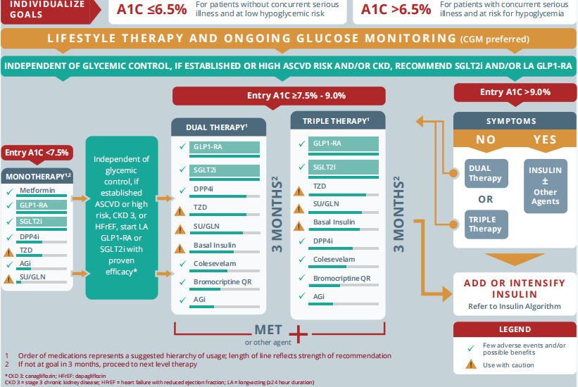

Slide 54
In metforminintolerant patients, two drugs with complementary mechanisms of action from other classes should be used
Fixed-dose (single-pill) combinations of oral agents including metformin and/or SGLT2 inhibitors, DPP4 inhibitors, TZDs, and SUs are available.
Addition of a third line agent may be needed to enhance Rx efficacy, although any third line agent is likely to have less efficacy than when the same medication is used as 1st /2nd line drug.

Slide 55
Liver diseases
Drugs usually do not require dose modification in mild to moderate liver disease.
But risk of hypoglycemia increases in severe cases.

Slide 56
Decision to start insulin!! When ???
Decision should be made in collaberation with the patient,depending on patients motivation,
CV and end organ complications,
age
risk of hypoglycemia and overall health status
COST considerations.
Patients taking two oral anti hyperglycemic agents who have an A1C >8.0% and or long-standing T2D are less likely to reach their target A1C with a third oral anti hyperglycemic agent

Slide 57
Controlling both fasting and postprandial glucose levels is necessary to achieve glycemic control.
At higher A1c levels, fasting glucose control is more beneficial in lowering A1c closer to the desired target of about 7 percent.
When A1c is closer to 7 percent, postprandial glucose control becomes more important.

Slide 58
When insulin becomes necessary a single daily dose of basal insulin analogue should be added to the regimen.
Dose should be adjusted at regular and fairly short intervals(days)
Basal insulin analogues are preferred to NPH because a single basal insulin analogue dose provides a relatively flat serum insulin concentration for 24 hrs or longer.
But basal insulin analogues and NPH have been shown to be equally efficacy In reducing A1C In clinical trials.

Slide 59
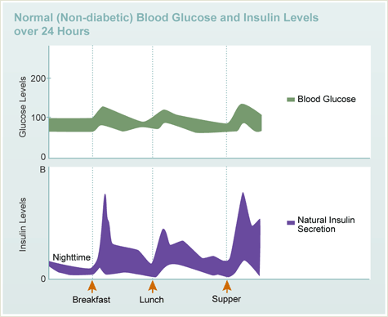

Slide 61
Pre mix human insulin
Combination of intermediete and regular insulin
Premixed insulin preparations are intended to simplify dosing and permits a lower number of daily insulin injections for people using more than one type of insulin.
Available as 70 p/30,,,70/25,,,,,50/50 preparations.
2/3 of total daily dose is given in morning
1/3 of the total dose at night
Typically, 50-75% of total daily dose is given as intermediate- or long-acting insulin

Slide 62
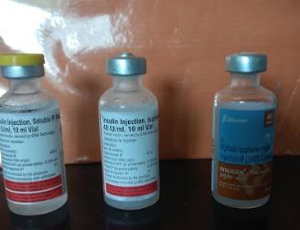
40u/ml
100u/ml
300u/ml

Slide 63
Premix insulin analogue
Combination of short acting insulin analogues and intermediete acting protamine suspension
Premixed insulin analogues and premixed human insulin have similar effects on A1c and fasting glucose.
However, premixed insulin analogues lead to lower postprandial glucose levels.

Slide 64
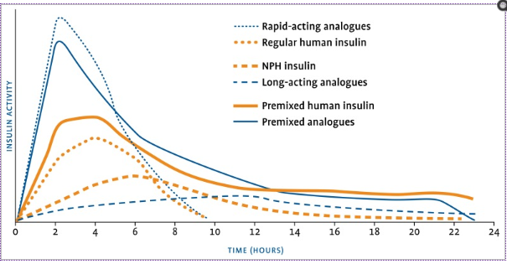

Slide 66
Uncontrolled A1C in spite of normal FBS
Probable culprit is post prandial hyperglycemia at noon
Here comes the role of ultra short acting insulin analogues/regular insulin in a patient who is already on basal insulin analogue of h.mixtard
Patients whose glycemia remains uncontrolled while receiving basal insulin in combination with oral agents or GLP1 receptor agonists may require mealtime insulin to cover postprandial hyperglycemia

Slide 67
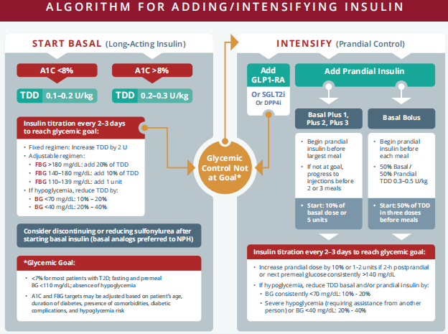

Slide 68
How to convert from nph to basal long acting insulin analogue
Add total NPH given per day and give 80% as a single dose of a basal analogue daily
Similarly regular insulin can be changed to ultra short cting insulin analogues with a 20% reduction in dose
10units RI→ change to 8 units of aspart

Slide 69
Human mixtard – 150 rs /400units

